Slide 1
HTHL Presentation
Group 3:
Benjamin King, Camryn Truban, Erin Mclaughlin, Nitesh Khakurel, Patrick Hedquist

Slide 2

Website
Using namecheap for domain and hosting service
Using HTTPS for URL
Using Elementor to edit the webpage visual
Using wordpress.org
A wide variety of plugins are being used to make the donate, advertisement, game and login pages work appropriately

Slide 3
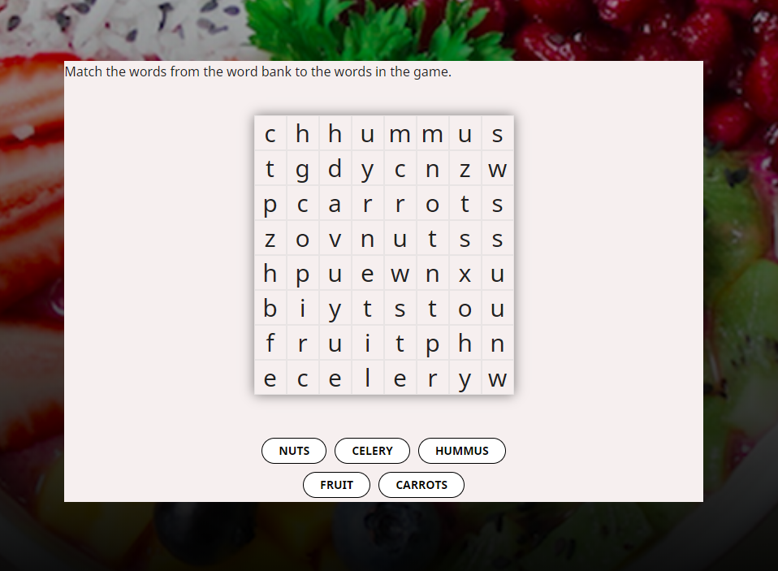
Game
The game is a simple word search
It contains different words on each level
Each level has a different theme about healthy life choices (healthy snacks, vegetables, proteins, fruit, activities, vitamins and minerals)
After each level is completed, users are prompted with a link to read more about each level’s theme
The game is compatible on all devices

Slide 4
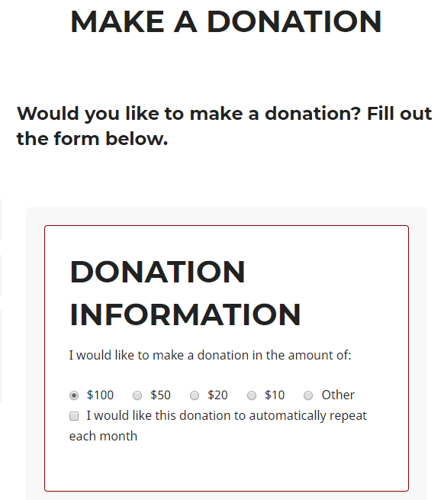
Donation
Users can make donations on our donation page
They can select the amount they want or create a custom amount
Their identity can be hidden
They can be reoccuring or one time payments
This feature is connected through paypal.com

Slide 5

Advertisement
Any potential advertisers can submit a form for the administrators to evaluate
There is no flat fee to advertise
Administrators and Advertisers will consulate on specifics of what, where, and how big the advertisements are.
The size of the ad
The exact location on the webpage
The frequency a user will see said ad

Slide 6
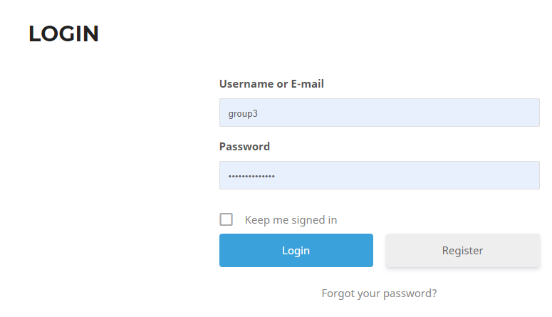
Login
Users can create an account based on whether they are a parent, child, or government official
Users will get redirected to the login page when accessing the game if they do not have an account
The parent user can monitor their children through the members tab
Users can delete and edit their account

Slide 7
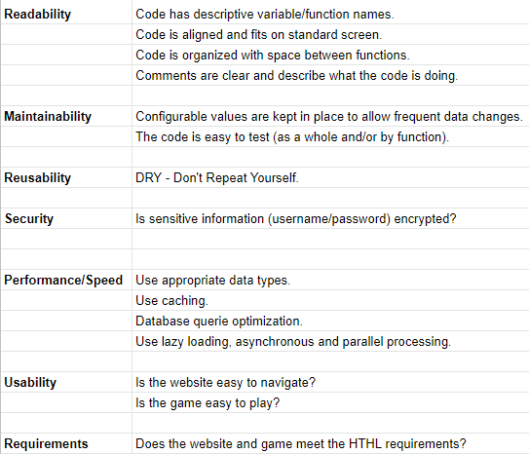
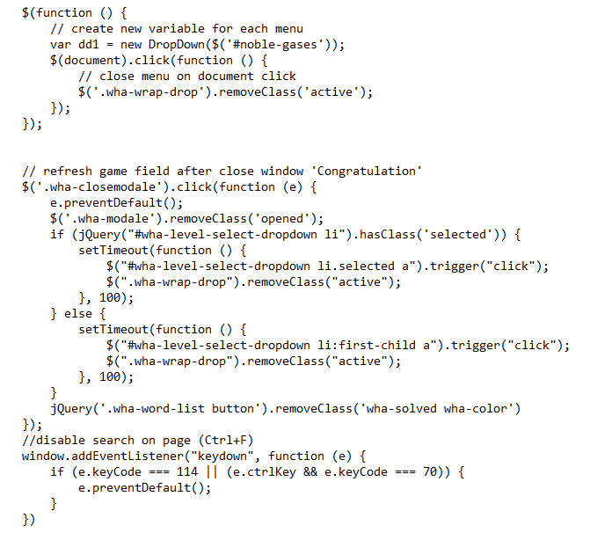
Evaluation of Code Review

